Slide 1
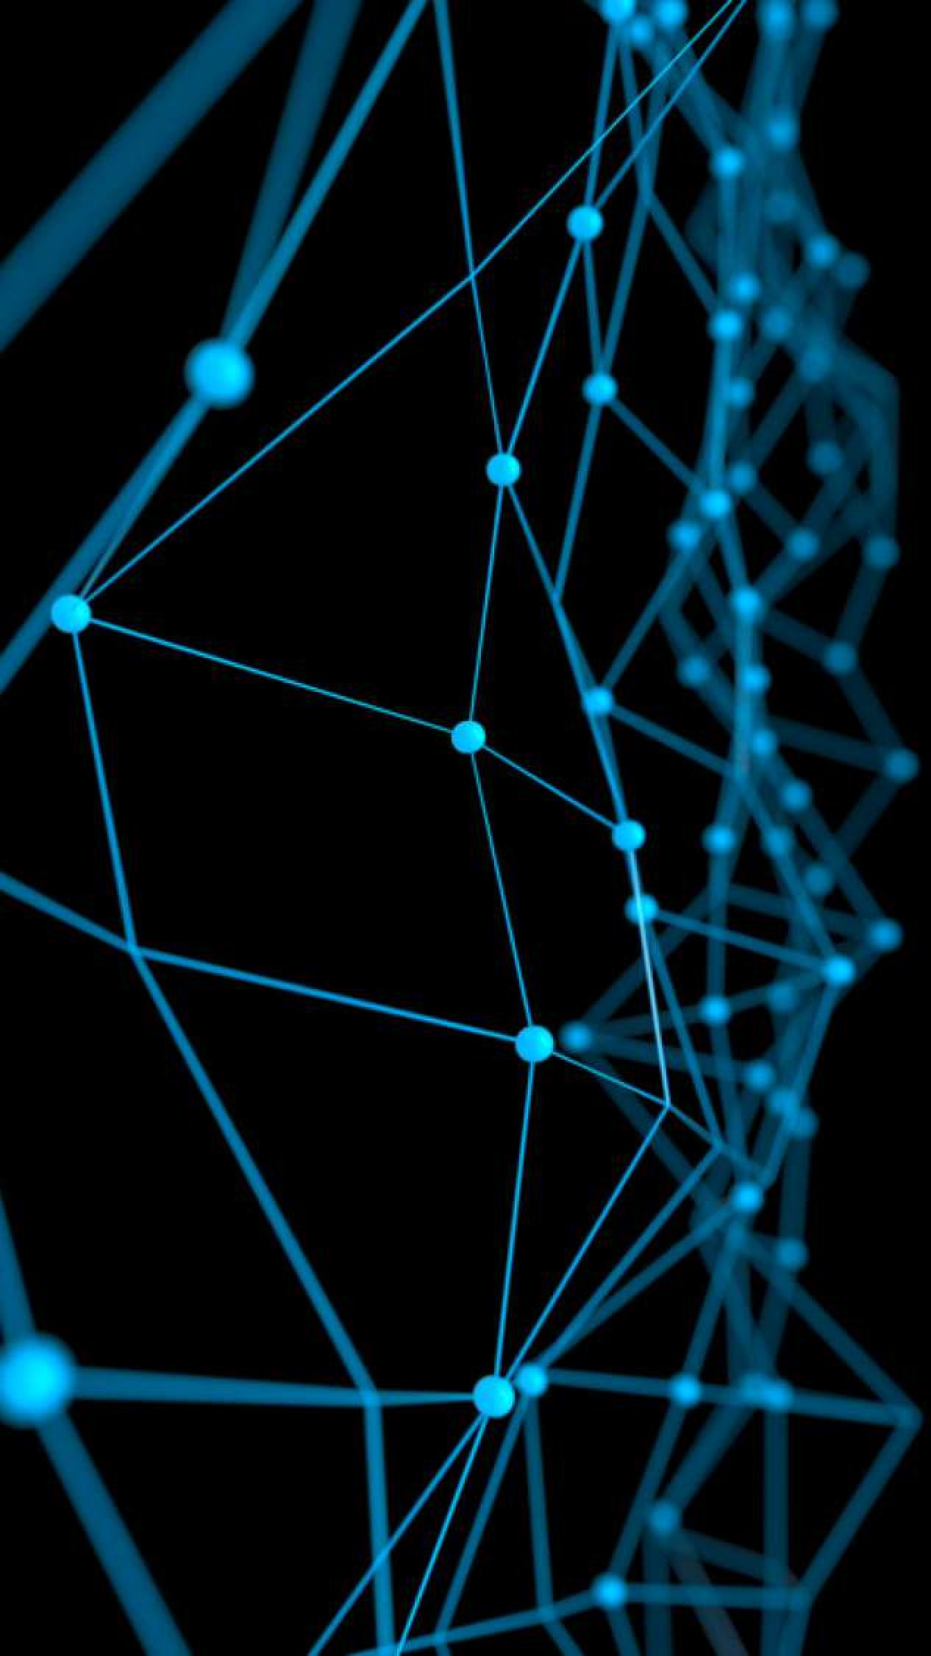
Deep Learning for Natural Language Processing:
Optical Character Recognition
June 2019

Slide 2
Optical Character Recognition
Optical Character Recognition (OCR) is the method of extracting text from images.
OCR is a field of research in pattern recognition, artificial intelligence and computer vision.

Slide 3
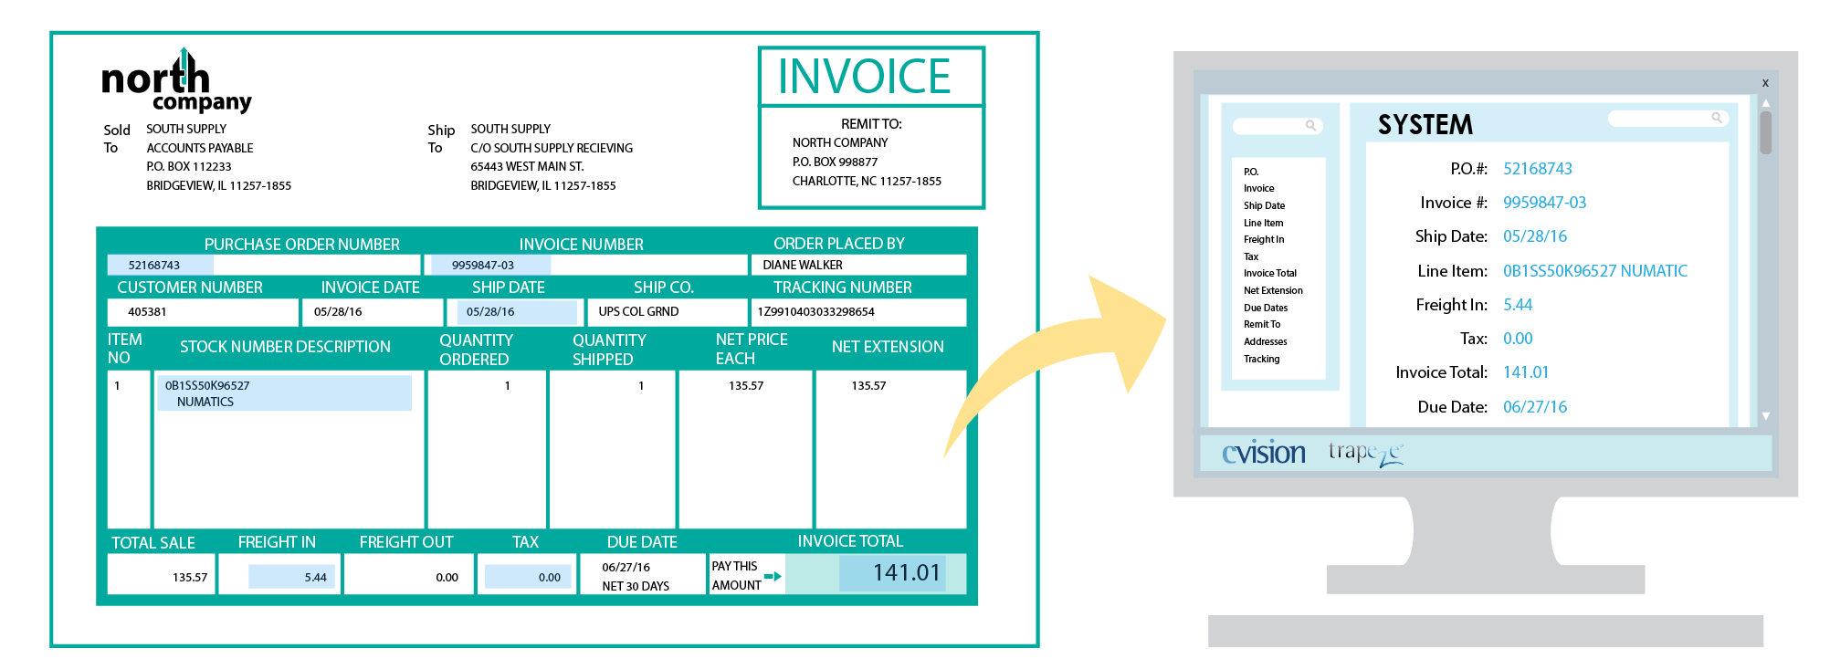
Optical Character Recognition
Scanned OCR

Slide 4
Optical Character Recognition
Photo OCR

Slide 5
Outline
Applications
Categories
Techniques
Pipeline for Photo OCR
Summary

Slide 6
Applications

Slide 7
Applications
Data entry for business documents, e.g. check, invoice, bank statement and receipt
Automatic number plate recognition
In airports, for passport recognition and information extraction
Automatic insurance documents key information extraction
Extracting business card information into a contact list
More quickly make textual versions of printed documents.

Slide 8
Applications
Make electronic images of printed documents searchable, e.g. Google Books
Converting handwriting in real time to control a computer (pen computing)
Defeating CAPTCHA anti-bot systems, though these are specifically designed to prevent OCR. The purpose can also be to test the robustness of CAPTCHA anti-bot systems.
Assistive technology for blind and visually impaired users

Slide 9
Categories

Slide 10
Categories
PDF OCR: The most common scenario for OCR is the printed/pdf OCR. The structured nature of printed documents make it much easier to parse them.
OCR in the wild: This is the most challenging OCR task, as it introduces all general computer vision challenges such as noise, lighting, and artifacts into OCR.

Slide 11
Techniques

Slide 12
Techniques: Pre-processing
De-skew: Tilt a few degrees clockwise or counterclockwise in order to make lines of text perfectly horizontal or vertical.
Binarisation: Convert an image from color or greyscale to black-and-white
Line removal: Cleans up non-glyph boxes and lines
Layout analysis or “zoning”: Identify columns, paragraphs, captions, etc.
Line and word detection: Establish baseline for word and character shapes, separates words if necessary.
Character isolation or “segmentation”
Normalize aspect ratio and scale.

Slide 13
Techniques: OCR
There are two basic types of core OCR algorithm:
Matrix matching: involves comparing an image to a stored glyph on a pixel-by-pixel basis; it is also known as "pattern matching", "pattern recognition", or "image correlation".
Feature extraction: decomposes glyphs into "features" like lines, closed loops, line direction, and line intersections.
E.g: Cuneiform, Tesseract

Slide 14
Techniques: Post-processing
Constrain by a lexicon - a list of words that are allowed to occur in a document.
Use co-occurrence frequencies to correct errors.
Use knowledge of the grammar of the language to correct errors.
Preserve the original layout of the page and produce.

Slide 15
Pipeline for Photo OCR

Slide 16
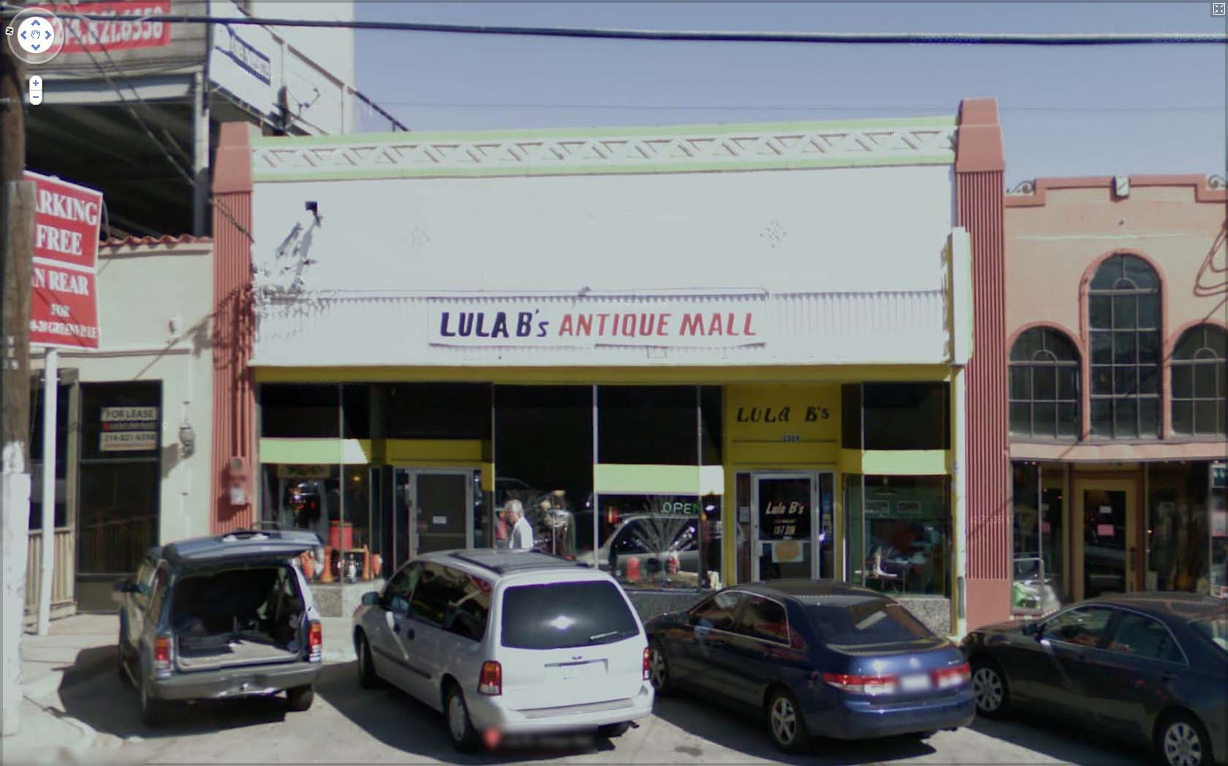
Photo OCR pipeline
1. Text detection
2. Character segmentation
3. Character classification
A
N
T
© Andrew Ng

Slide 17
Photo OCR pipeline
Image
Text detection
Character segmentation
Character recognition
© Andrew Ng

Slide 18
Text detection: Sliding windows

Slide 19
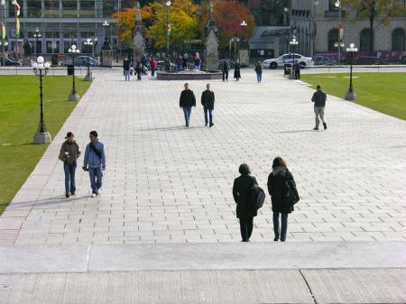
Text detection
Pedestrian detection
© Andrew Ng

Slide 20


























Supervised learning for pedestrian detection
pixels in 82x36 image patches
Positive examples
Negative examples
© Andrew Ng

Slide 21
Sliding window detection
© Andrew Ng

Slide 22
Sliding window detection
© Andrew Ng

Slide 23
Sliding window detection

Slide 24
Sliding window detection
© Andrew Ng

Slide 25
Text detection

Slide 26
Text detection
Positive examples
Negative examples
© Andrew Ng

Slide 27
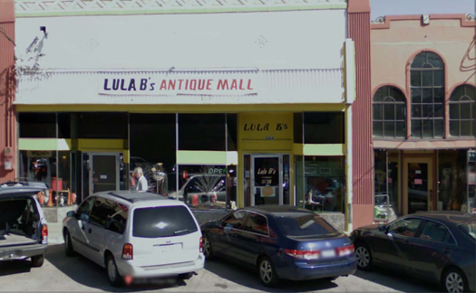
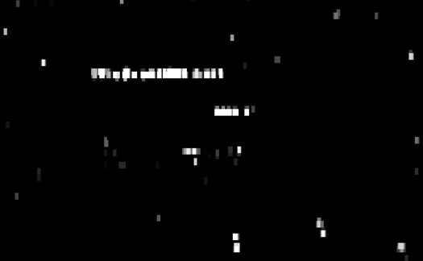

Text detection
[David Wu]
© Andrew Ng
Notes:
Expansion
Rectangles around operator

Slide 28
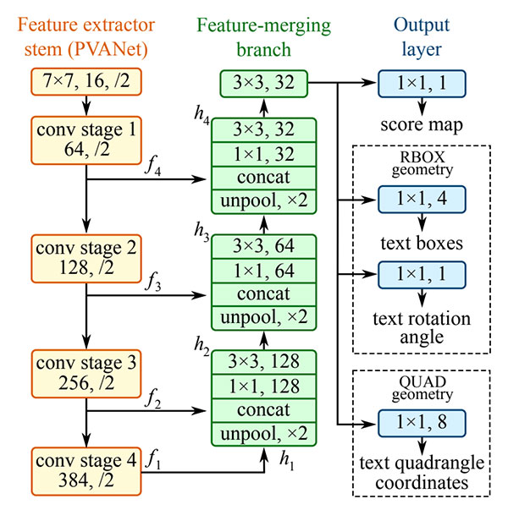
EAST: Efficient accurate scene text detector
Notes:
Expansion
Rectangles around operator

Slide 29
Character segmentation: 1D Sliding windows

Slide 30
Character segmentation: 1D Sliding windows
Positive examples
Negative examples
© Andrew Ng
Notes:
Change it to segmentation examples instead:

Slide 31
Character recognition

Slide 32
Character recognition
A
N
T
I
Q
A
© Andrew Ng
Notes:
Sort it, spell antique

Slide 33
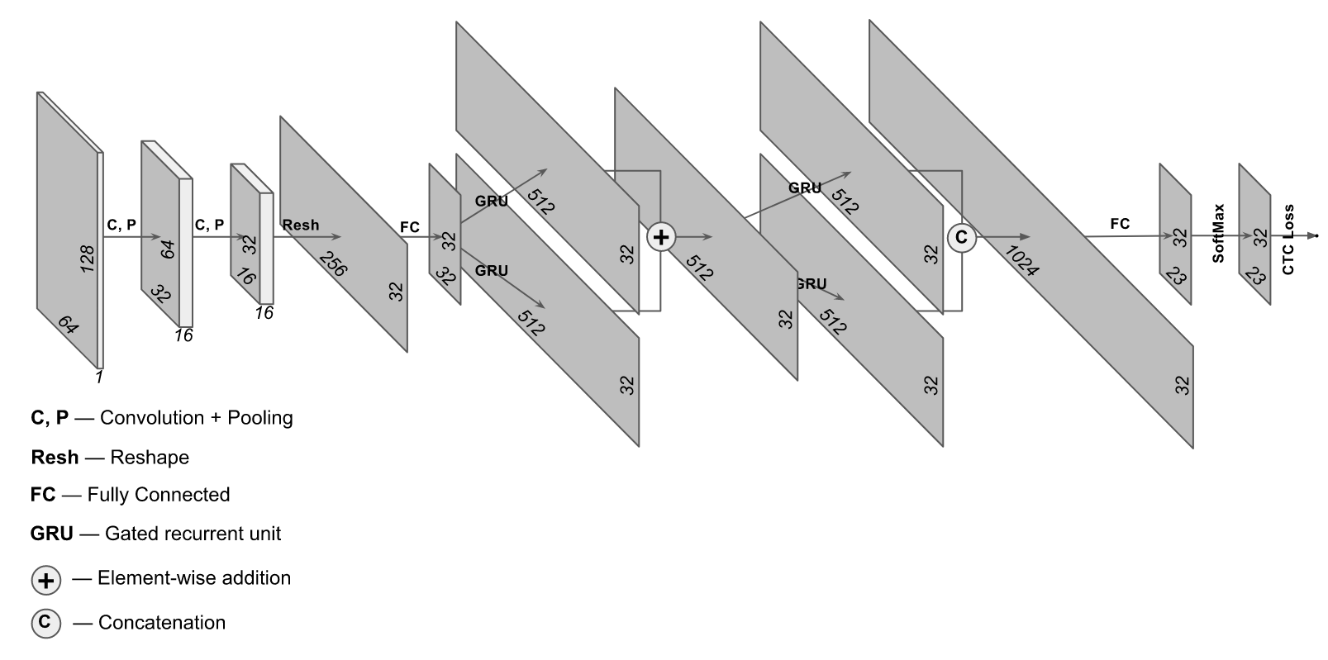
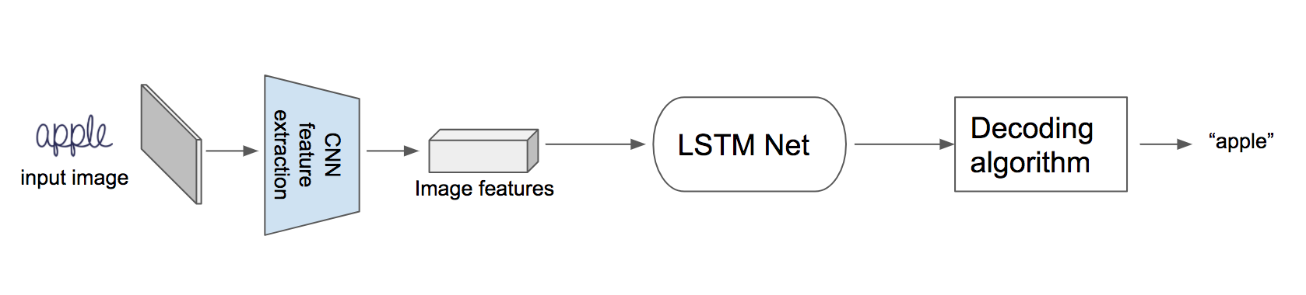
Character recognition

Slide 34
Character recognition

Slide 35
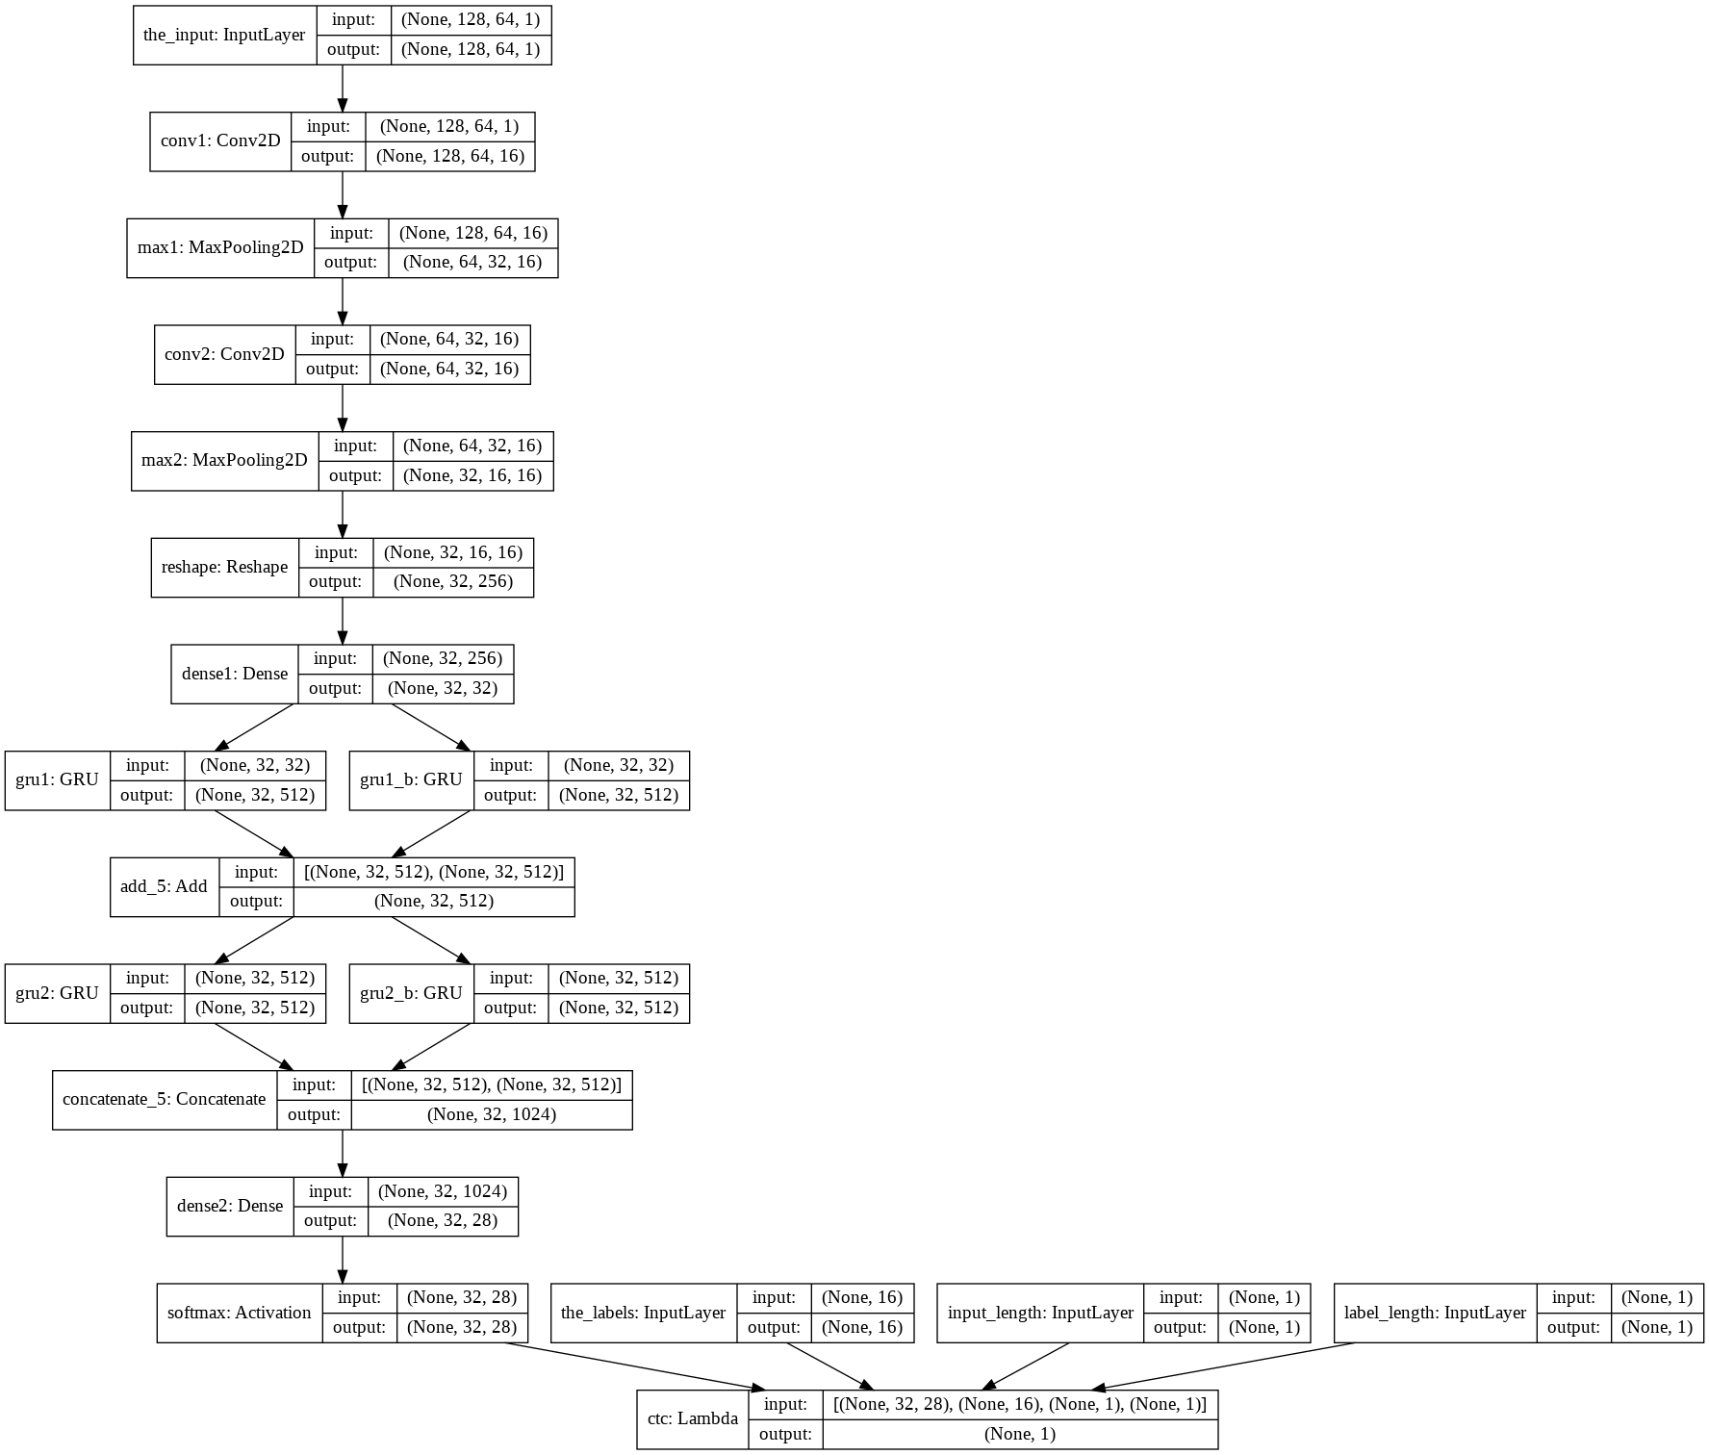
Notes:
Sort it, spell antique

Slide 36
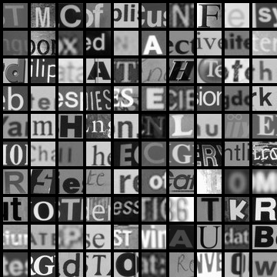
Artificial data synthesis for photo OCR
Abcdefg
Abcdefg
Abcdefg
Abcdefg
Abcdefg
Real data
[Adam Coates and Tao Wang]
© Andrew Ng

Slide 37
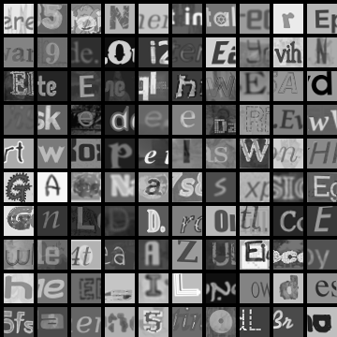
Artificial data synthesis for photo OCR
Real data
Synthetic data
[Adam Coates and Tao Wang]
© Andrew Ng

Slide 38
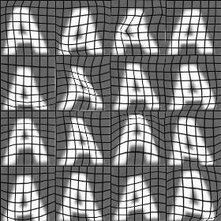

Synthesizing data by introducing distortions
[Adam Coates and Tao Wang]

Slide 39
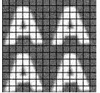

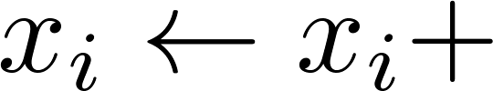
Synthesizing data by introducing distortions
Distortion introduced should be representation of the type of noise/distortions in the test set.
Audio:
Background noise,
bad cellphone connection
Usually does not help to add purely random/meaningless noise to your data.
intensity (brightness) of pixel
random noise
[Adam Coates and Tao Wang]
© Andrew Ng
Notes:
2x2, add noise

Slide 40
Summary
PDF OCR
OCR in the wild.
Pipeline for Photo OCR
Links:
https://github.com/tesseract-ocr/tesseract

